Slide 1
Introduction to Rust Programming language
By Kent Marete
Twitter: @kentccs github: maretekent

Slide 2
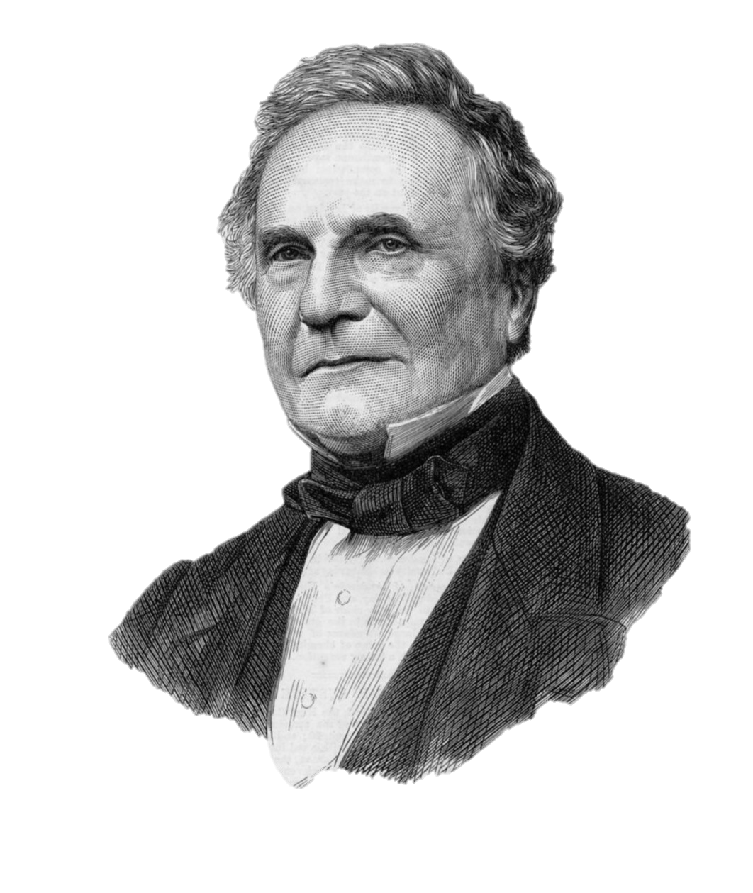
History of computers
First "computer” word use was recorded in 1613 - referring to a person calculations, or computations.
Tools –Abacus, Napier bones, slide rule, pascaline, stepped reckoner etc.
Difference Engine and Analytical Engine - first mechanical computer
Invented by Charles Babbage in 1822 and 1834
Charles Babbage

Slide 3

History of computers
In 1840, Augusta Ada Byron suggests to Babbage that he use the binary system.
She writes programs for the Analytical Engine.
She was the first programmer
Ada lovelace

Slide 4
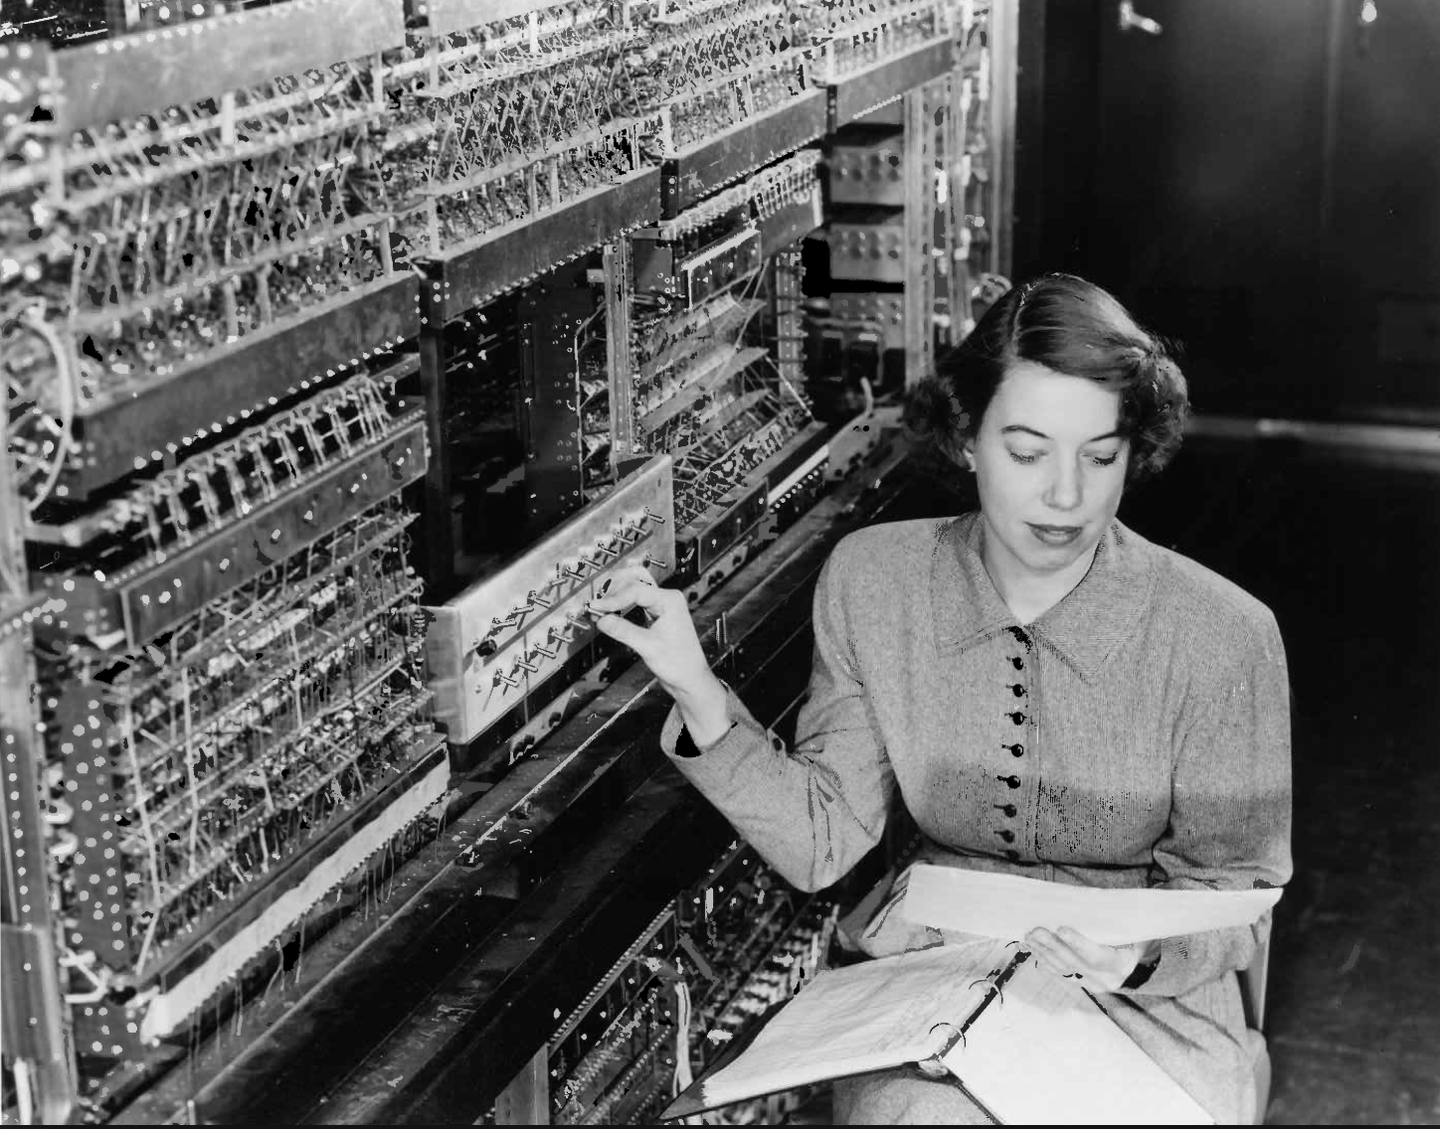
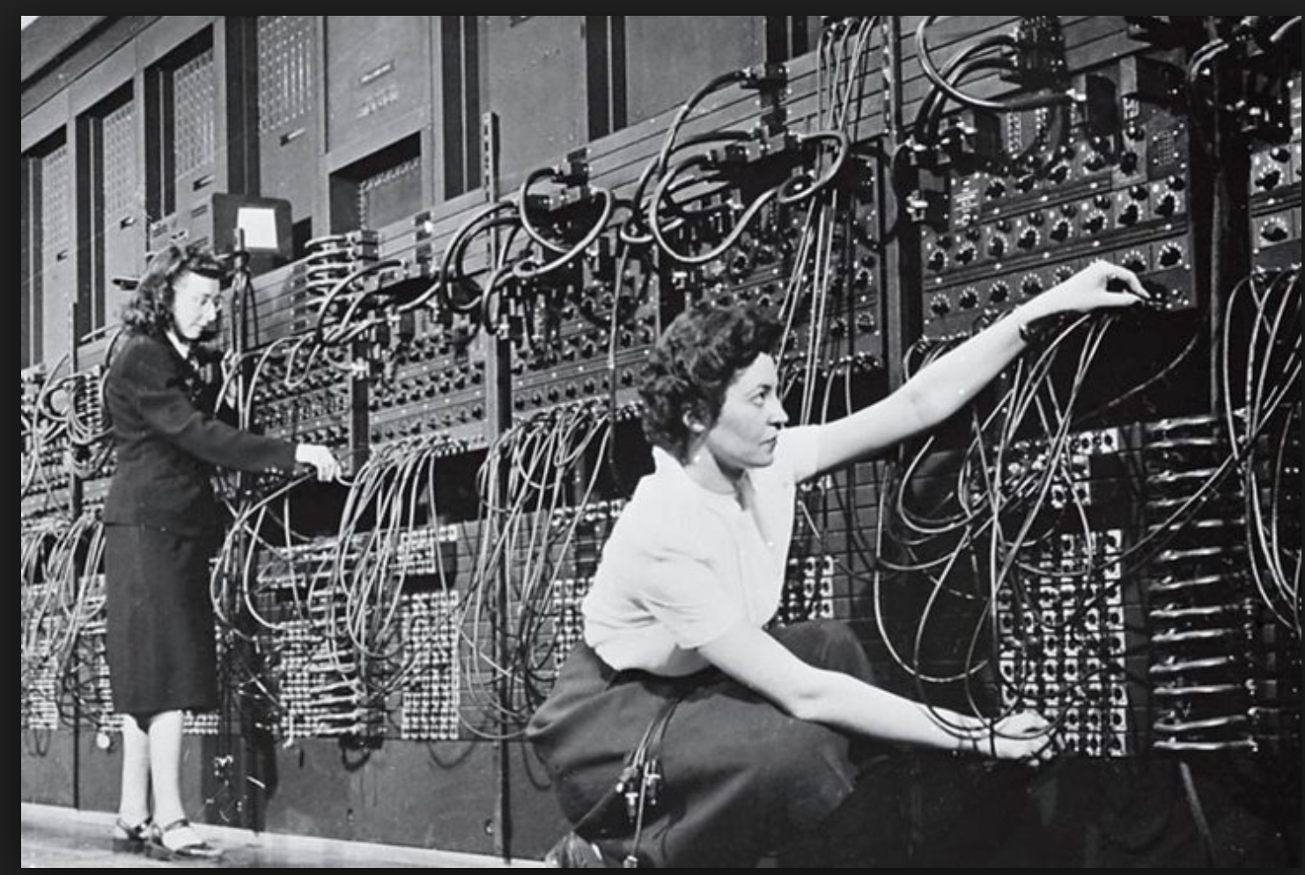
First Programmers early 1930’s, 40’s
ACE

Slide 5
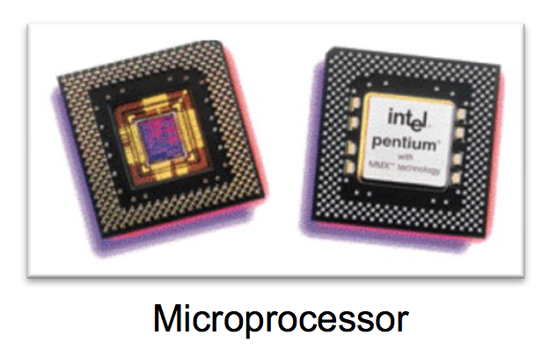
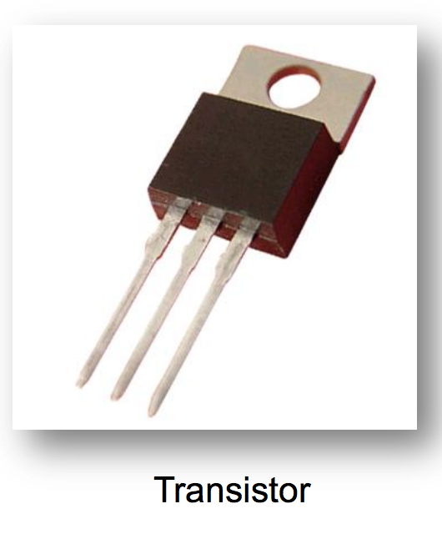
Computer Generations
There are five generations
First generation – 1946 – 1958 -- vacuum tubes for circuitry and magnetic drums for memory. -solve one problem at a time
Second generation – 1959 - 1964 -- Transistors replaced vacuum tubes
Third generation – 1965 - 1970 -- integrated circuit - silicon chips
Fourth generation – 1971 - today – microprocessor many ICs
Fifth generation – Today to future -- Artificial Intelligence (AI)

Slide 6
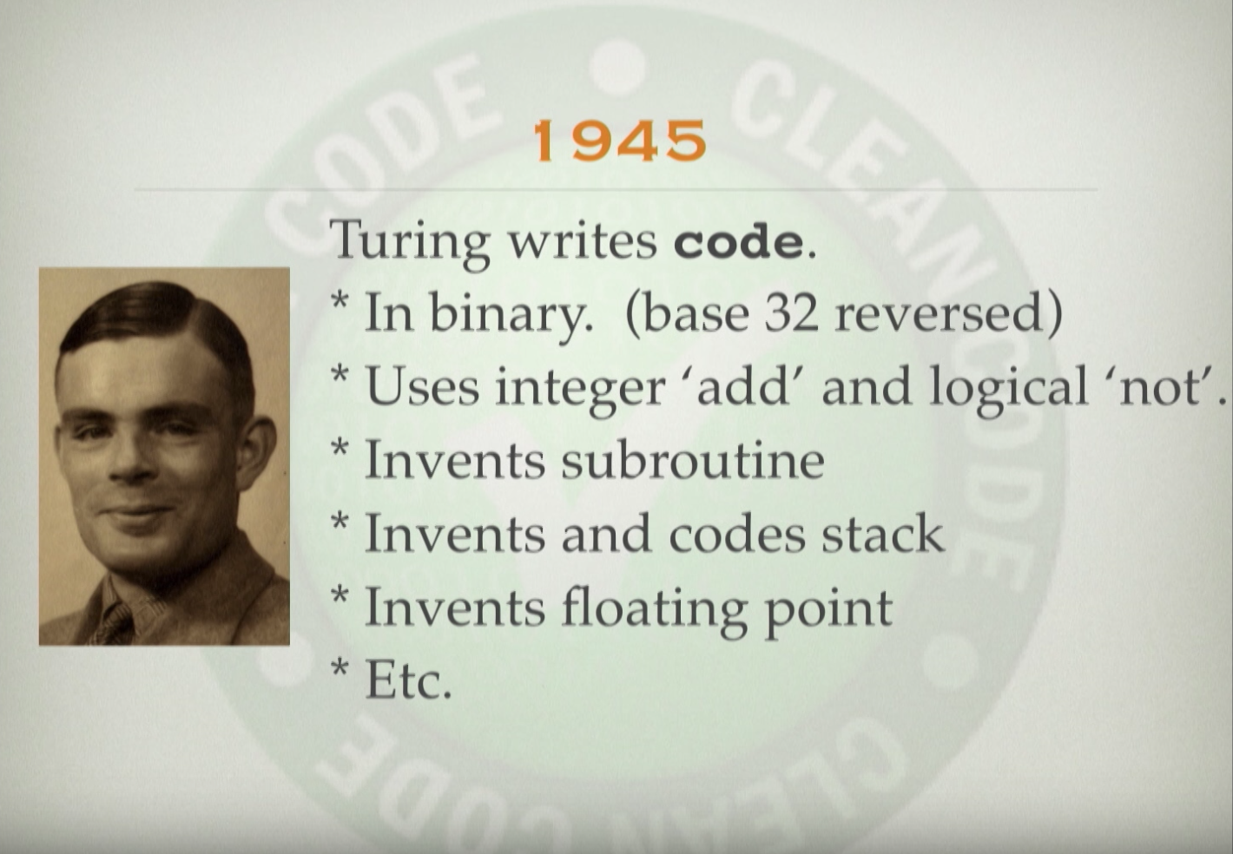
Father of modern Computers

Slide 7
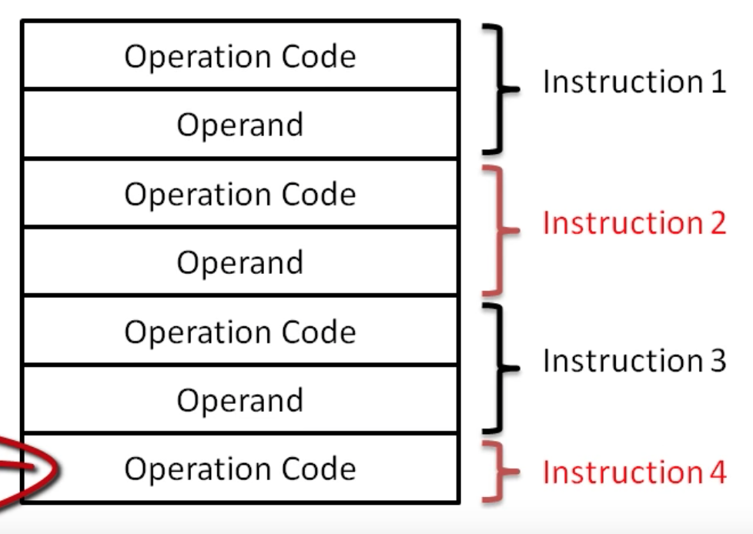
Machine code
Instruction consist of operation code (op code) and Operand
All are binary codes
Machine code program consists of seq. of op code and operand are stored in computer memory e.g. RAM
operand -part of a computer instruction that specifies data
Op code - part of a computer instruction that specifies what operation
LD A, 01H
Hex
Opcode (load)
Data (1)
Register

Slide 8
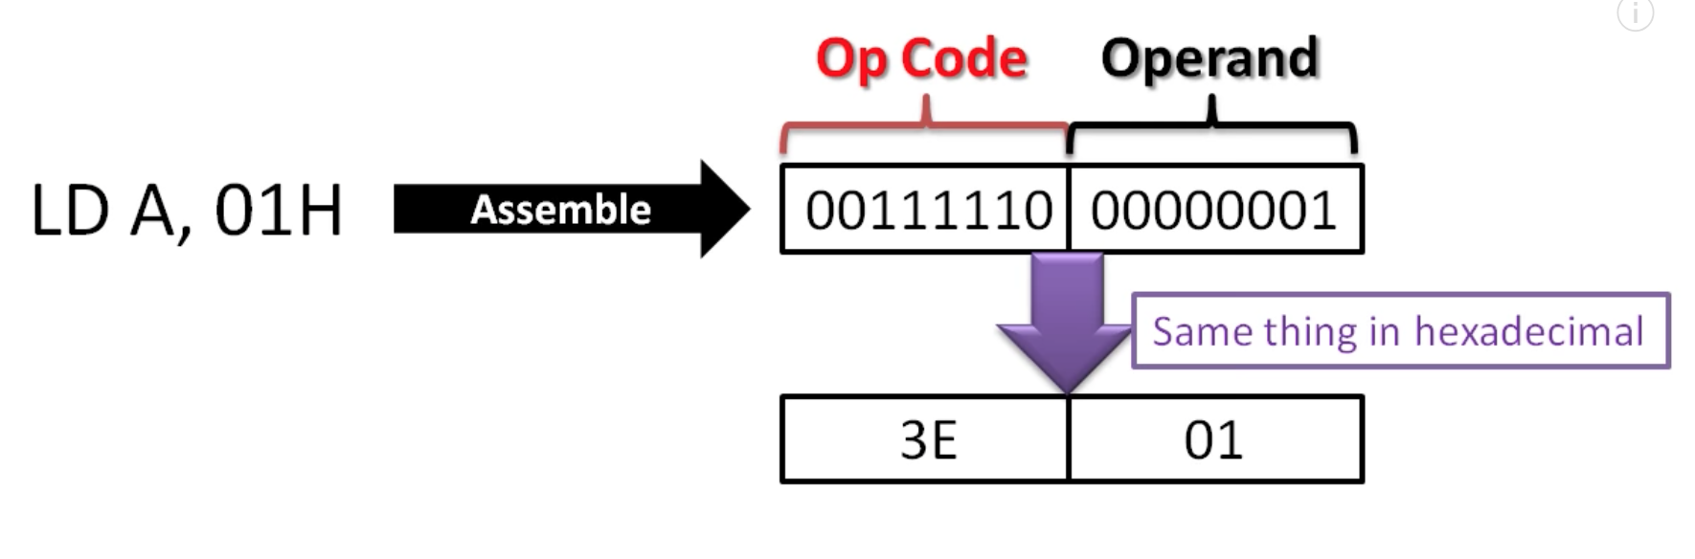
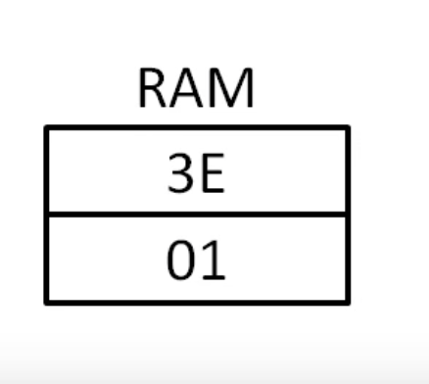
Machine code
opcode
operand
Assembly -- Mnemonics
MOV A, B

Slide 9
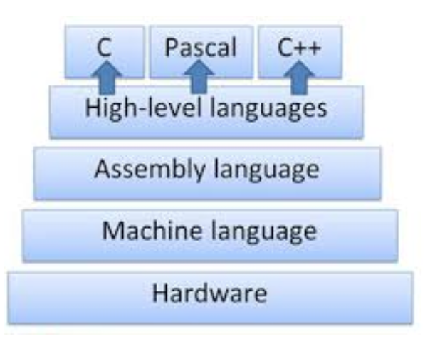

High Level programming Languages
Program - Set of instructions
Programming - The art of creating programs
HLL – uses mathematical symbols and english like syntax, easy to learn, read.
01010100011010101000111101111010
Compiler,
Interpreters and assemblers
Low level language

Slide 10
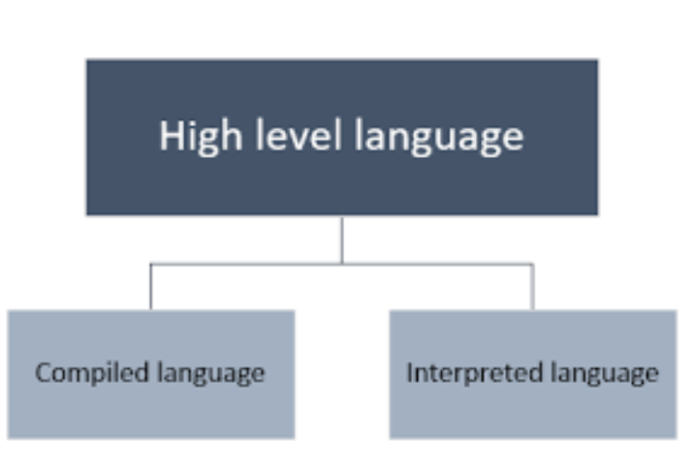
High Level programming languages
Compiled languages - compiled code can be executed directly by the computer's CPU.
the original program is translated into native machine instructions, which are executed directly by the hardware
Interpreted languages - translated at run-time from any format to CPU machine instructions

Slide 11
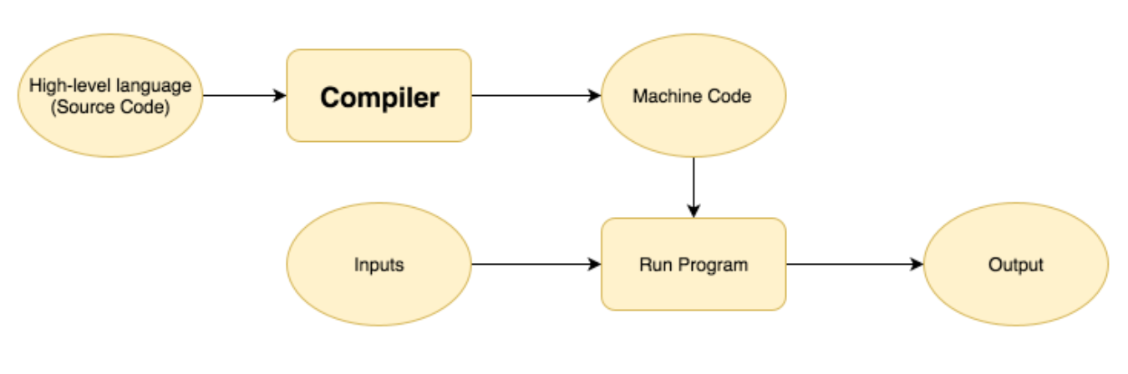
High Level programming languages
HLL are portable and can run on multiple computers unlike low level languages
Commands
Syntax
logic
Compiler - translates comp. program in HLL to machine code
Interpreter - translates comp. program in HLL to machine code line by line

Slide 12
High Level programming languages
Movie translation scenario - subtitles --- compiler
Summit meetings interpretation of foreign lang --- interpreter
Compiled lang: C, C++, Rust, Fotran, COBOL
Interpreted lang: Python, Perl, Ruby
Systems programming is making of systems program.
Systems program are used to develop application programs

Slide 13
What is Rust?
Rust is a systems programming language that runs blazingly fast, prevents segfaults, and guarantees thread safety. (safety, concurrency, and speed)
It’s a programming language founded by Mozilla research.
Rust
Javascript
D
C++
go
Java
Perl
Scala
Python
C#
Haskell
Ruby
PHP
C
Notes:
It gives us control, we know what will run on our machines

Slide 14
What Rust has to offer
We can organize these languages in a linear spectrum
JS
Haskel
Python
D
Java
Scala
Ruby
C
C++
Control
Safety
RUST

Slide 15
What Rust has built? / who is using Rust?
Wasm – editors, browser game engines, https://www.figma.com https://www.youtube.com/watch?v=ysFJHpS-O08
Games - https://www.amethyst.rs/ -https://kripken.github.io/BananaBread/cube2/bb.html
Block chain – etherium, exonum, crytape
Friends of Rust - https://www.rust-lang.org/en-US/friends.html
Jumo – cloud env manager

Slide 16
Table of content
Rust, Cargo, Setup
Syntax + Concepts mostly the same as other languages
Syntax + Concepts particular to Rust

Slide 17
What is Cargo?
Package manager
Build tool
Test runner
Documentation generator

Slide 18
Setting up a Project
We're going to be making a binary project; the other option is a library.
cargo new will create a skeleton project setup for you.
cd to a directory where you like to store code
cargo new rustbridge
cd rustbridge
If you use version control, now would be a good time to commit.

Slide 19
Files created
Cargo.toml: metadata about your project and its dependencies
.gitignore: ignores compiled files built by Rust
src/main.rs: where your Rust code goes

Slide 20
Cargo.toml
[package]
name = "rustbridge"
version = "0.1.0"
authors = [”Kent Marete <maretekent@gmail.com>"]
[dependencies]

Slide 21
src/main.rs
fn main() {
println!("Hello, world!");
}

Slide 22
Run it!
cargo run
Should print "Hello, world!"
Now you have more files:
target directory: all the built stuff
Cargo.lock: locks your dependencies (we don't have any yet)
Try printing out something else!
Try printing out two things!

Slide 23
Syntax + Concepts mostly the same as other languages

Slide 24
Comments
Double slash at the beginning of a line (//)
Try commenting out one of your lines printing!
There are other kinds of comments but this is the most common

Slide 25
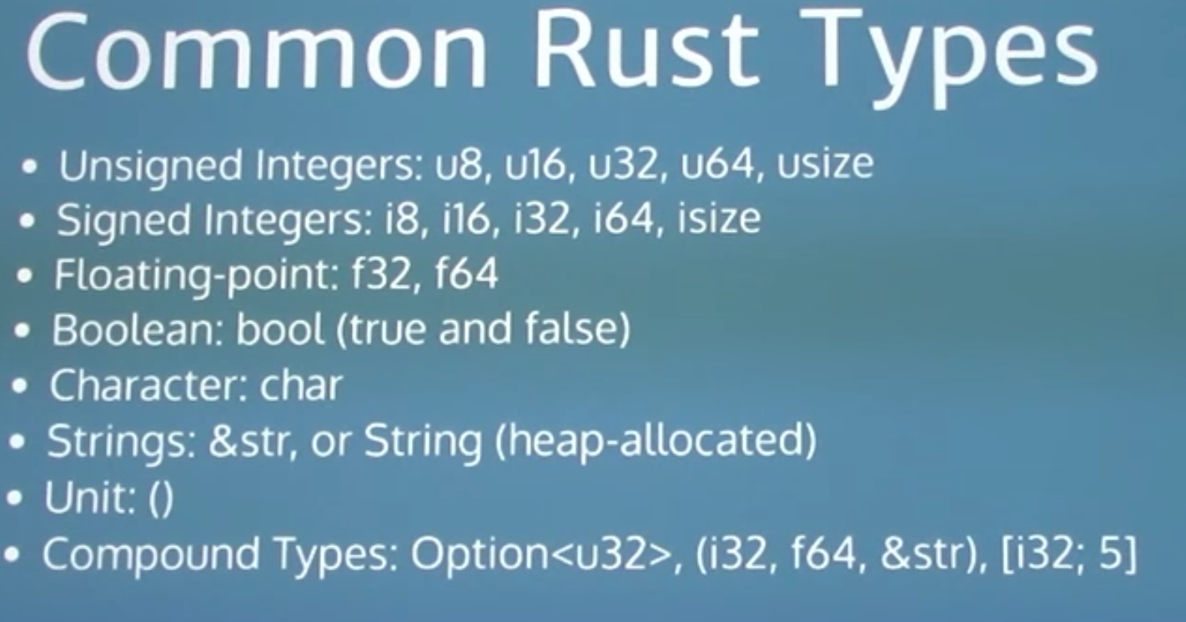

Slide 26
Variables
let a:u8 = 123; // unsigned, immutable
let mut b:i8 = 0; // mutable
let mut c = 123456789; // it's an i32!
let d:char = 'x'; // no type deco, single 32-bit unicode character
let f:f64 = 2.5; // default float type
let g = false; // true, g is of type boolean
let name = "ashley";

Slide 27
Mutability
let mut apples = 100;
apples += 50;
println!("I have {} apples", apples);

Slide 28
Type inference
Every value has a type that the compiler has to know about.
Most of the time, the compiler can figure it out.
Sometimes it can't, and you'll get an error and need to add an annotation.
We could have written let age: i32 = 30;
A place we must specify types is function definitions.

Slide 29
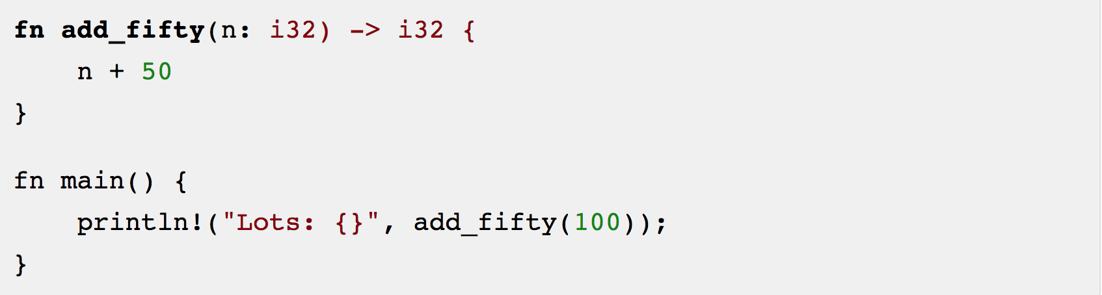
Functions

Slide 30
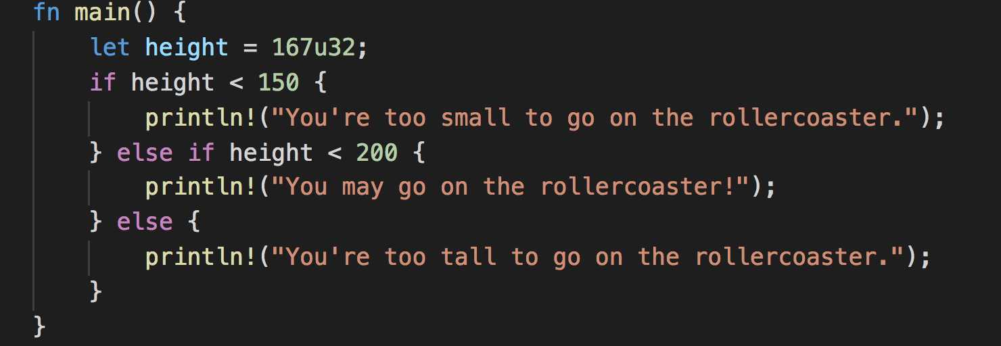
Conditionals if

Slide 31
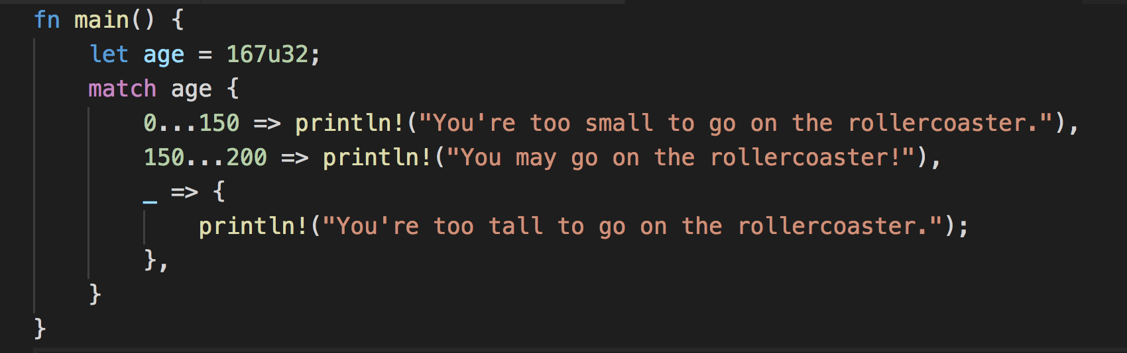
Conditionals match

Slide 32
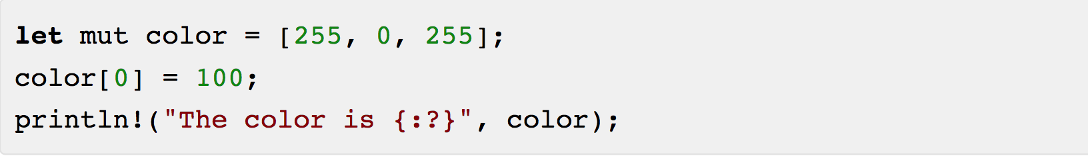
Arrays

Slide 33
Quick but Useful Tangent #1: println! formatting
{} is called Display formatting; only on primitive types by default
{:?} is called Debug formatting; more types have this by default
Display is for end users, Debug is for... debugging
Rust doesn't want to make assumptions
My favorite: {:#?} = pretty debug

Slide 34
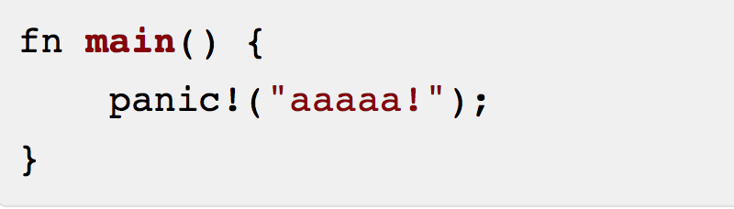
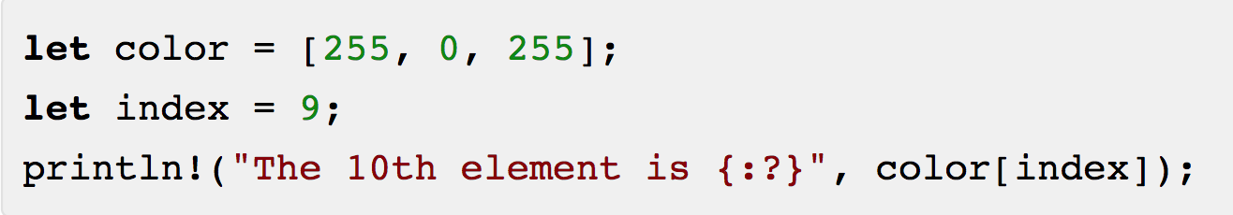
Quick but Useful Tangent #2: panic!
Panic stops your program with a message.
What happens in the last example if we try to access an element out of bounds of the array?

Slide 35
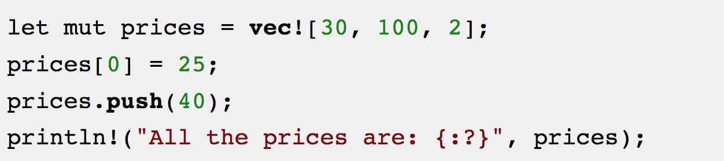
Vectors
Vectors are dynamic arrays

Slide 36
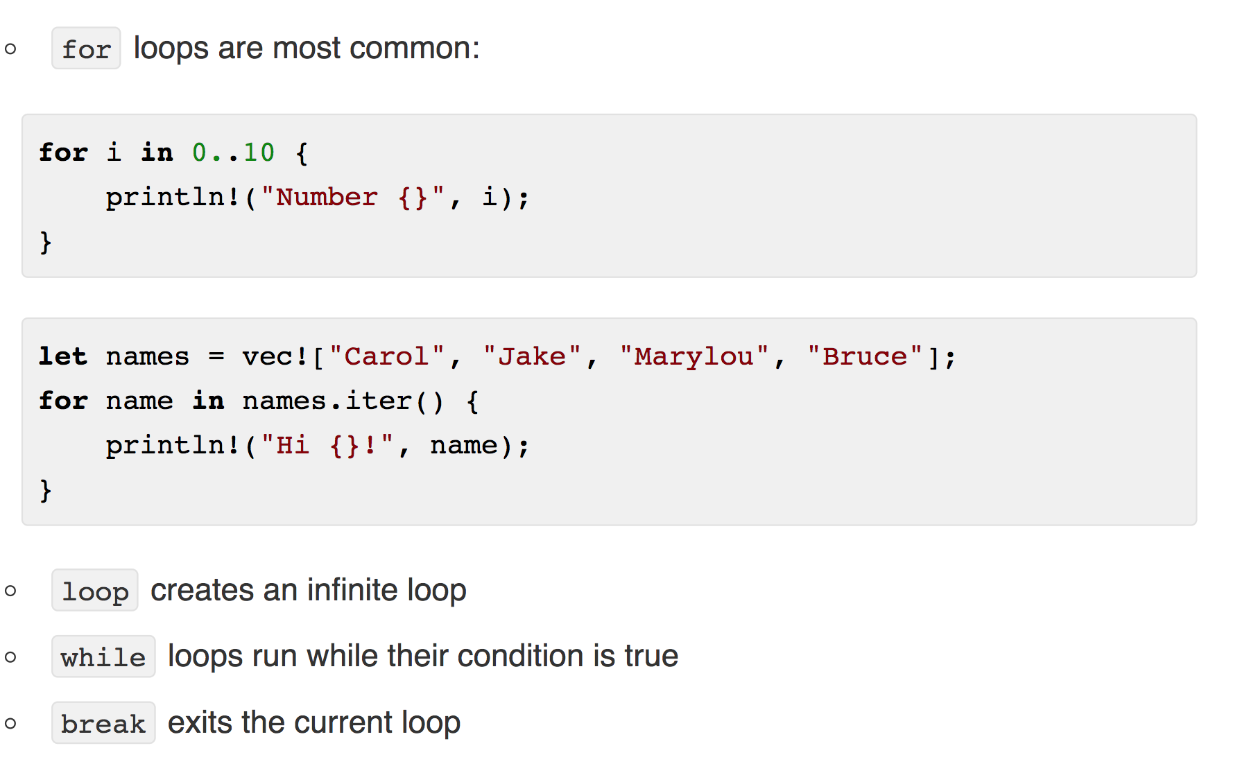
Looping (and ranges)

Slide 37
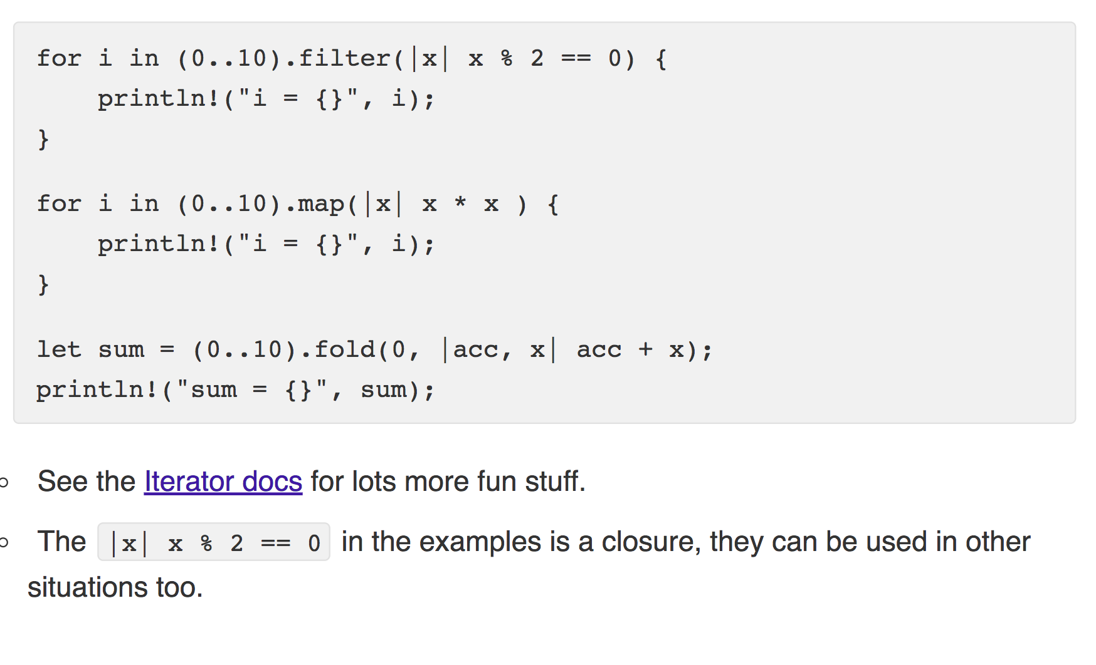
Iterators

Slide 38
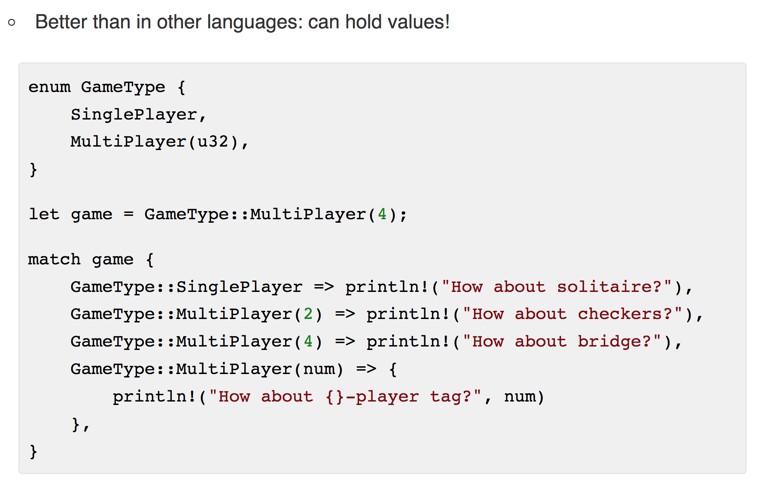
Enums

Slide 39
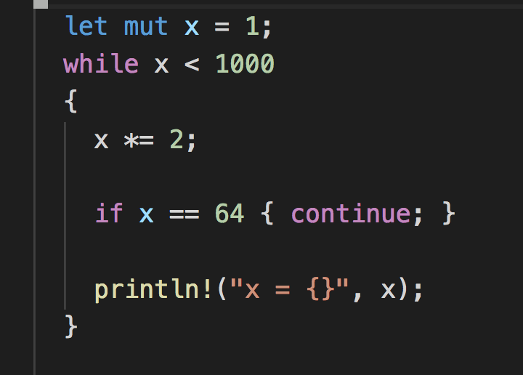
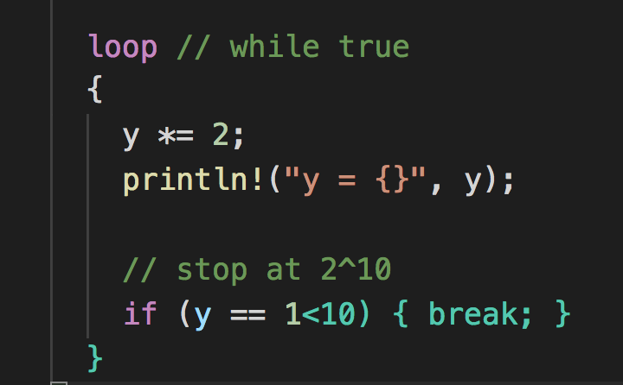
Control Flows
While loop
loop

Slide 40
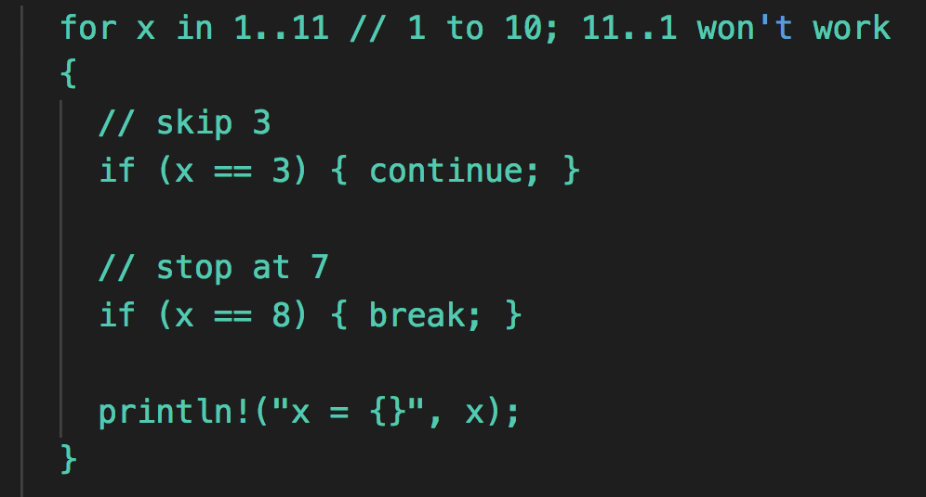
Control flows
For loop
Match
if

Slide 41
Syntax + Concepts particular to Rust

Slide 42
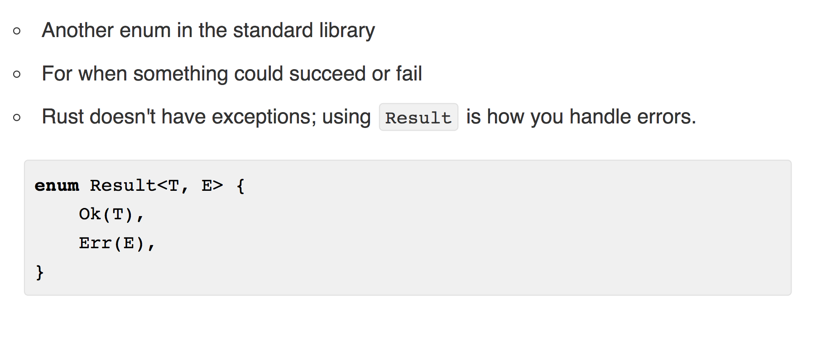
Result

Slide 43
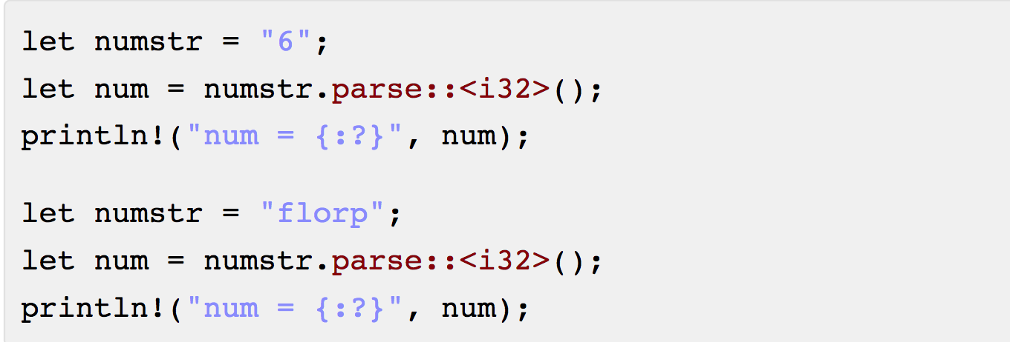
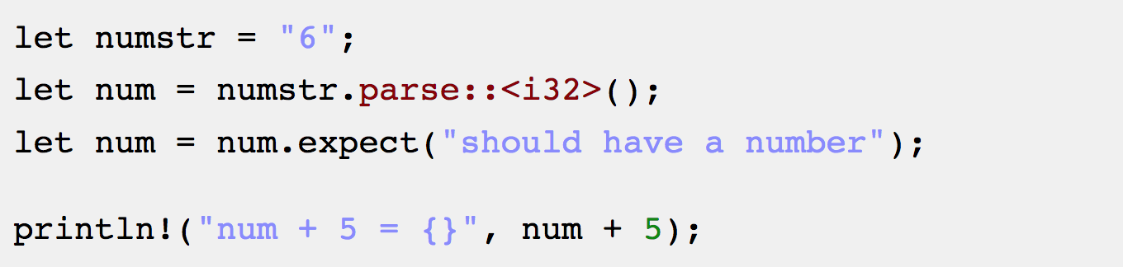
Result

Slide 44
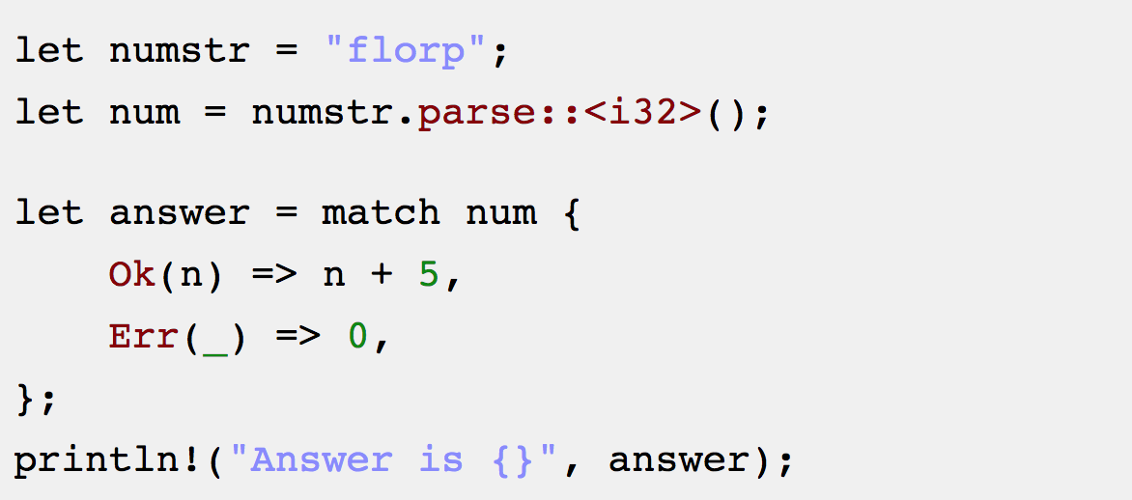
Result

Slide 45
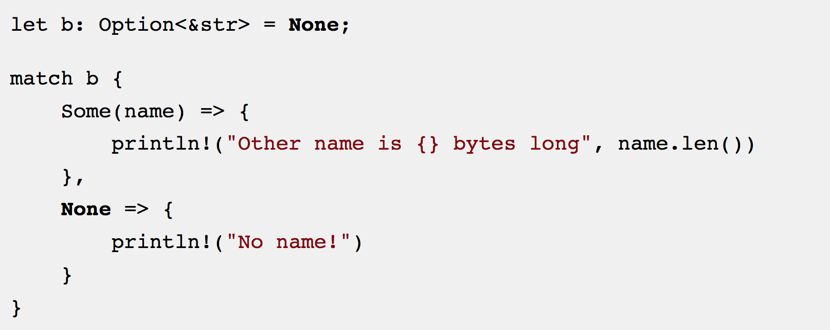
Option

Slide 46
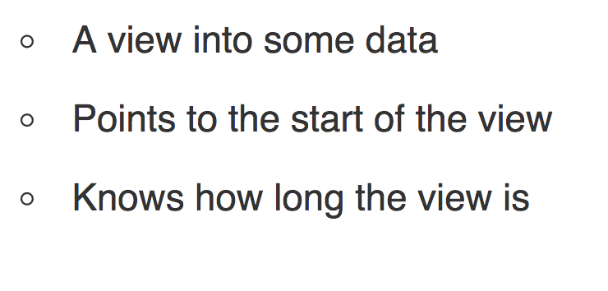
Slices

Slide 47
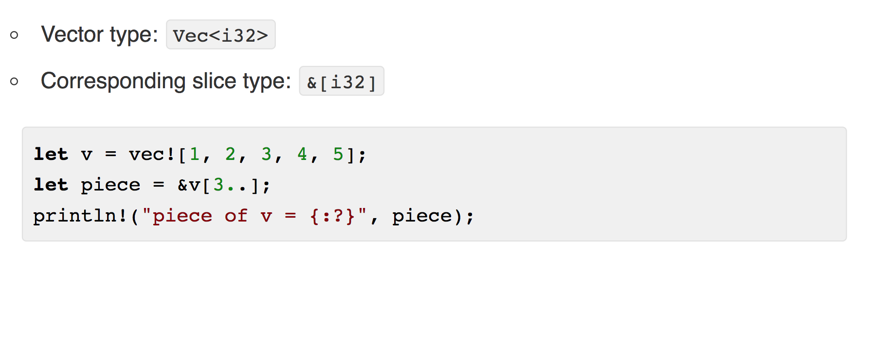
Slices Syntax

Slide 48
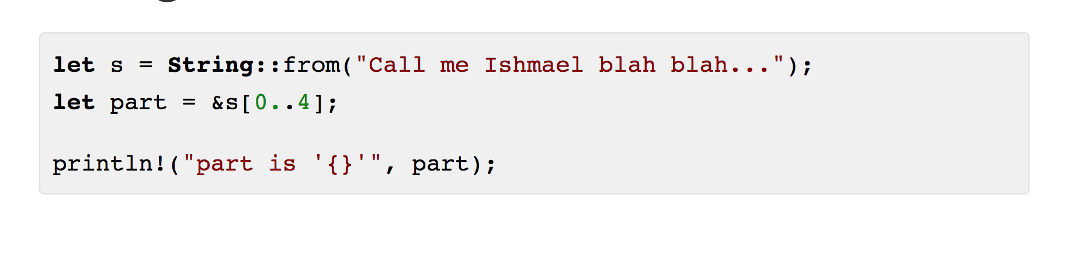
String Slices

Slide 49
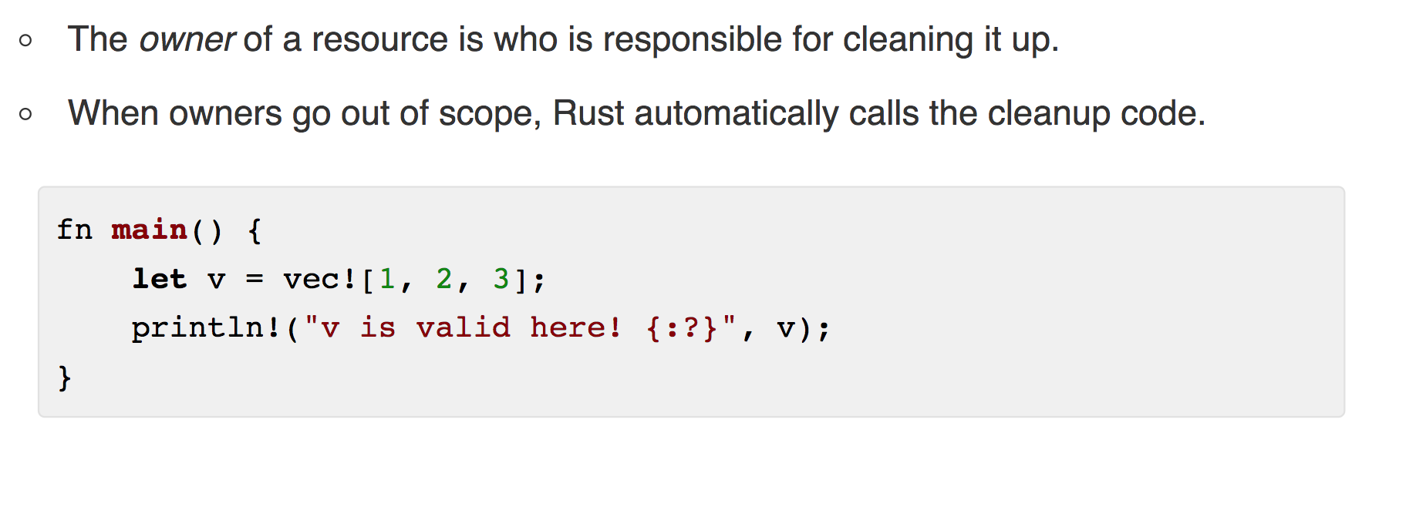
Ownership

Slide 50
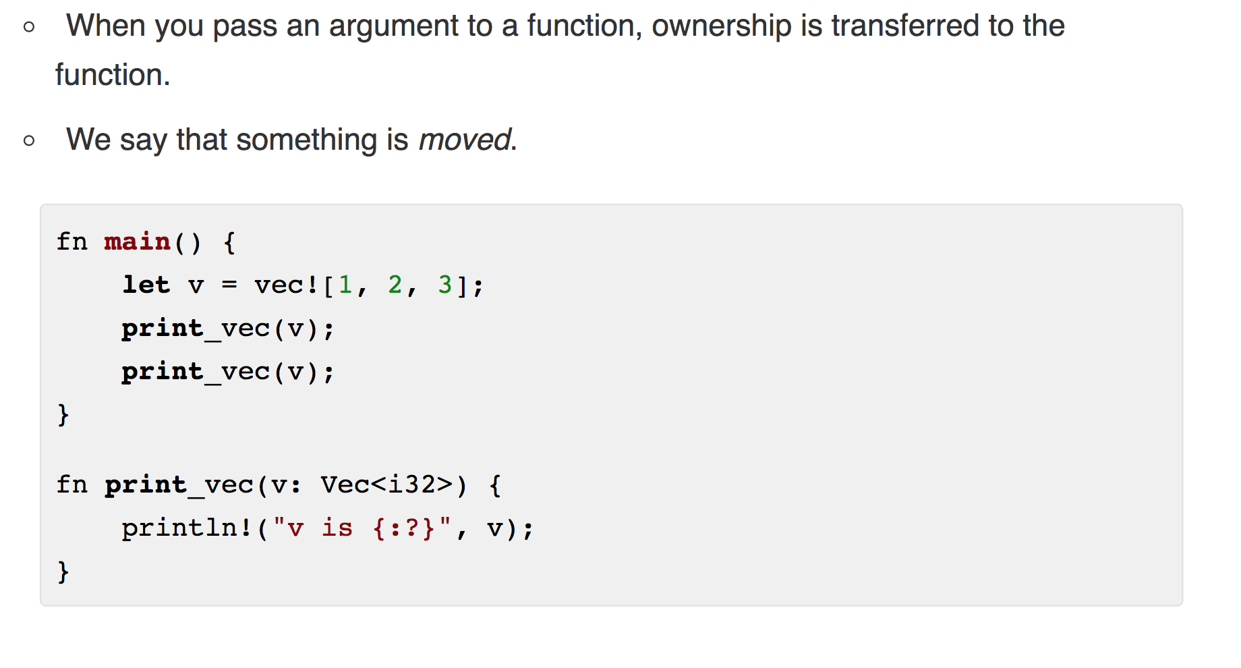
Transferring Ownership

Slide 51
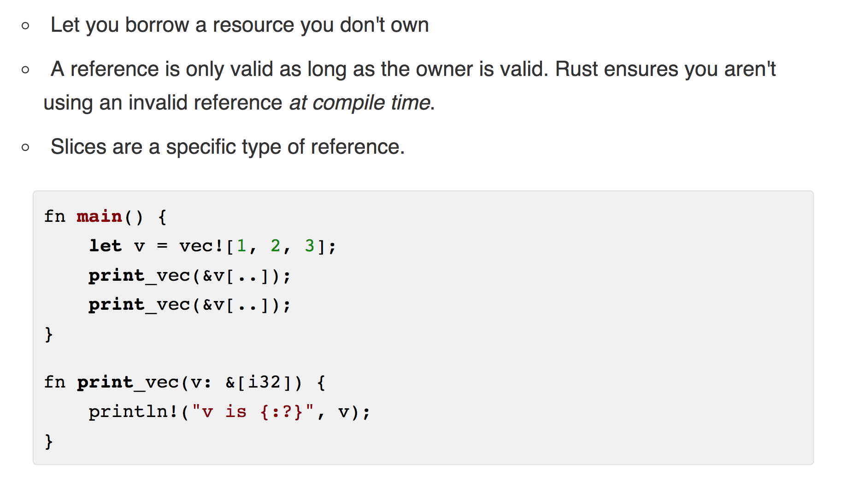
References

Slide 52
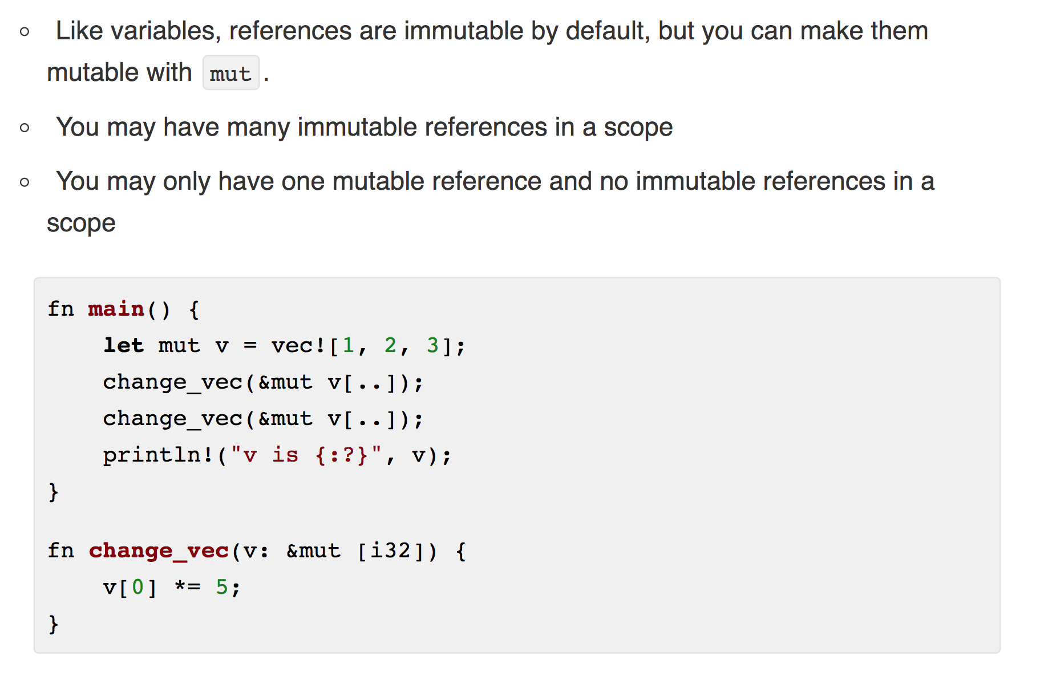
Mutable References

Slide 53
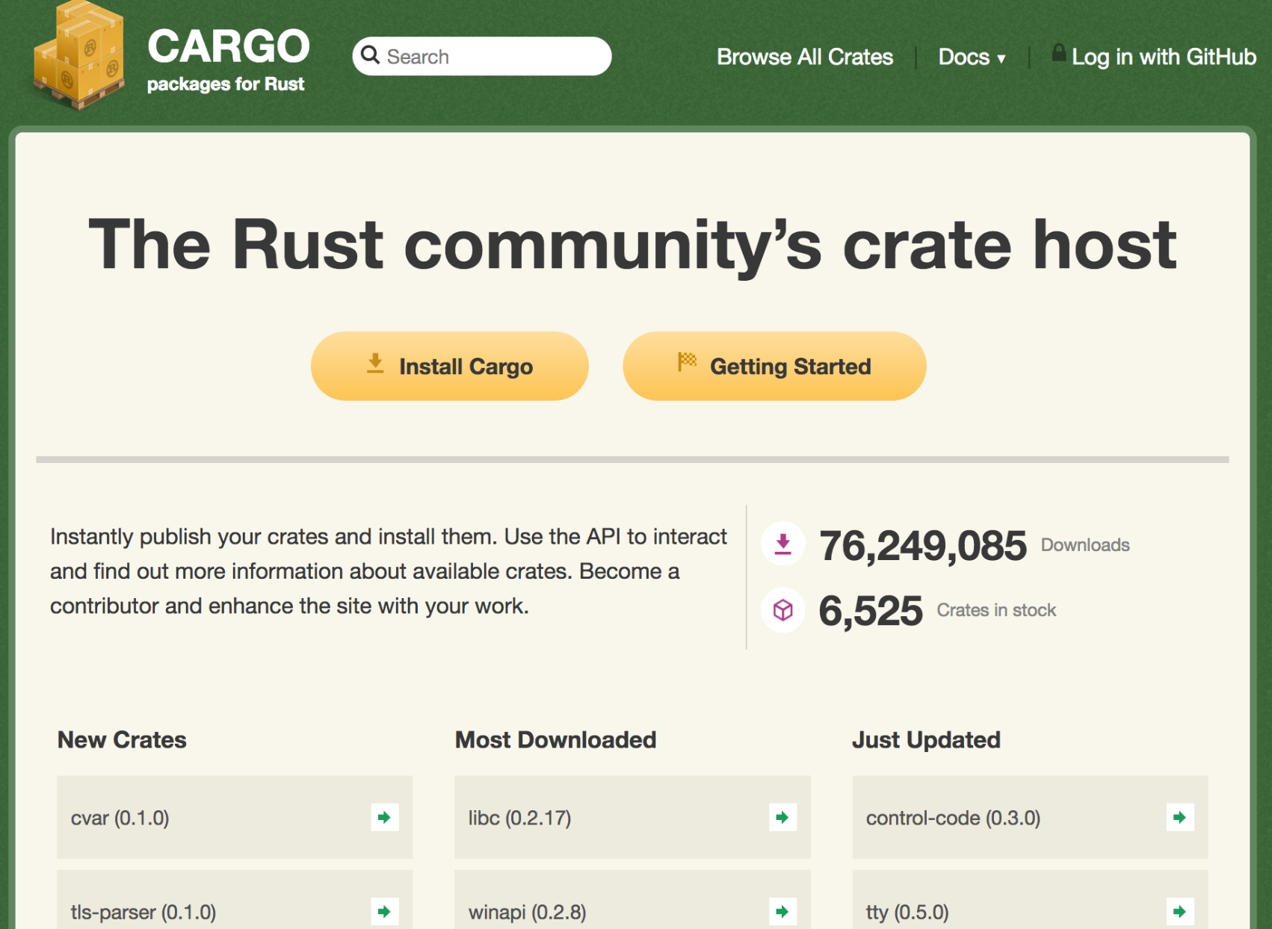
Crates
http://crates.io

Slide 54
End

